Slide 1
Resting Alpha state activity related to SNR 50
Methods
Participants (n=32): Mean age=65 (31-78). Mild to moderate hearing loss. Hearing aid users
Measures:
Alpha power (7.5-12.5 hz) in occipital brain regions
Signal to noise ratio (SNR) threshold at 50% correct (SNR-50)
Subjective measures of hearing loss
EEG
64-channel EEG monitored using Neuroscan
Reference – Cz. Ground – Afz
Eyes alternate between open and closed conditions lasting 2 minutes each. 3 trials. 12 minutes total
EEG data analyzed in Matlab using Fieldtrip
Data bandpass filtered between .5 and 50 hz
Independent component analysis removed components related to signal, eye movement, and cardiac noise
FFT analysis run using Hanning window
Alpha power calculated between 7.5 and 12.5 hz
Alpha peak selected between 7.5 and 12.5 hz. Peak +/- 2hz are selected as a 4 hz window.
Alpha peak power is calculated around 4 hz window

Slide 2
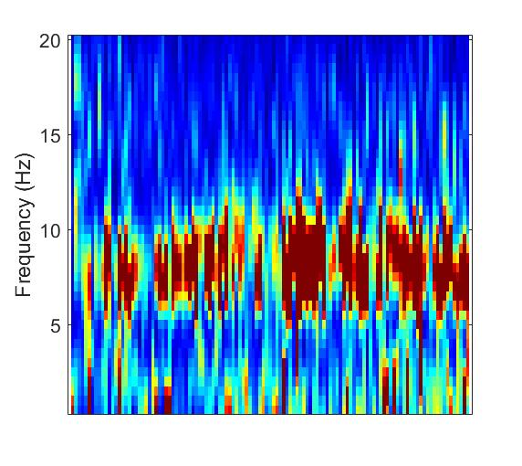
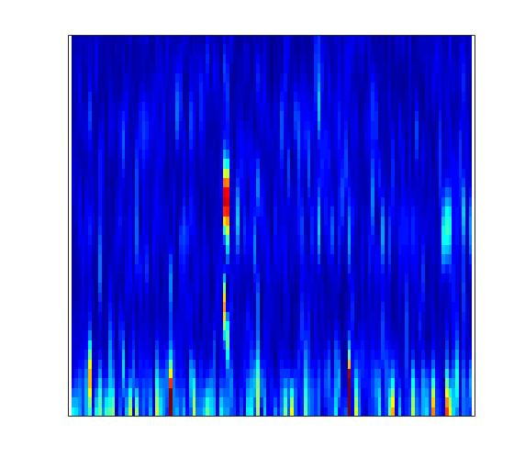
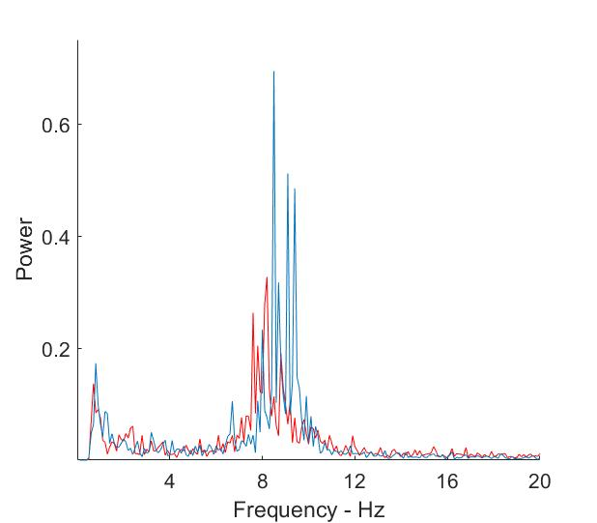
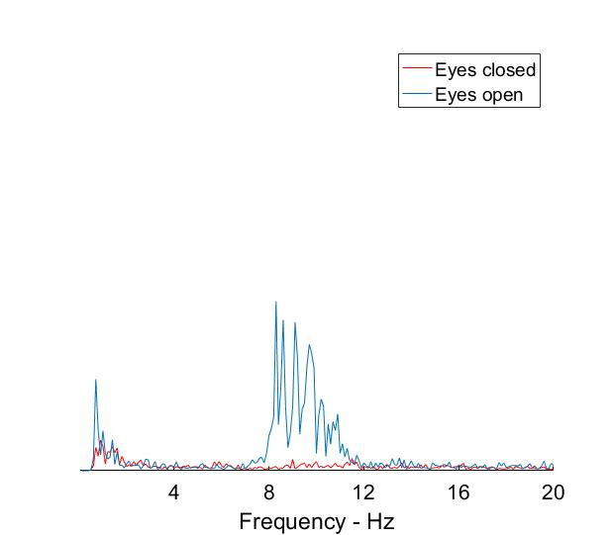

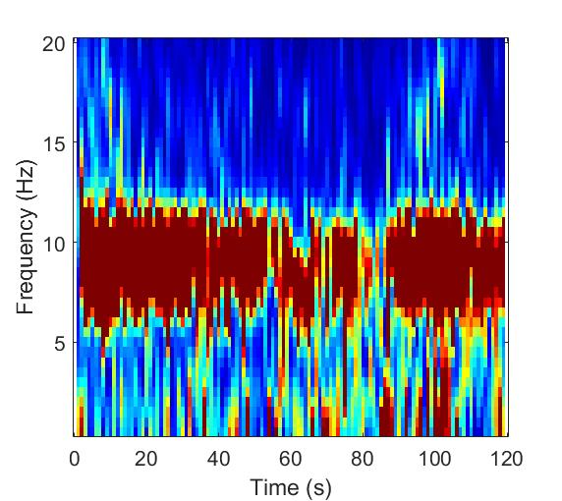
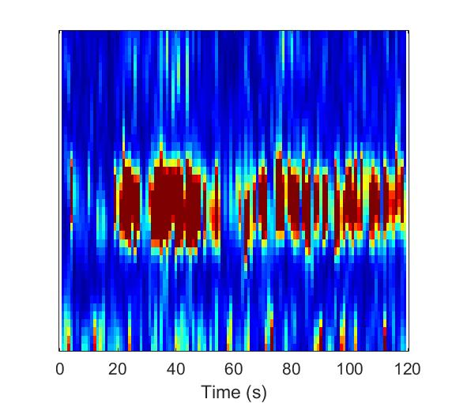
Sample Spectral data from single subject
Power
Frequency (Hz)
Frequency (Hz)
Time (seconds)

Slide 3
SNR study
MoCA – Montreal Cognitive Assessment
Test Box Measures
ANSI
DIR (SNR = 3)
DNR (AC 70 dB)
ANL (Unaided) – Acceptable Noise Level
HINT/PPT (Unaided)- Hearing In Noise Test
Real Ear Measures
MLST & Listening Effort Estimates – Multimodal Lexical Sentence Test
APHAB – Abbreviated Profile of Hearing Aid Benefit
HHIE/HHIA – Hearing Handicap Inventory for Elderly
DOSO – Development of the Device-Oriented Subjective Outcome SADL – Satisfaction with Amplification in Daily Life IOI-HA – International Outcome Inventory for Hearing Aids
SSQ12 – Speech Spatial and Qualities of Hearing
ALDQ
LESQ
NEO-FFI
Reading Span
Word Span

Slide 4
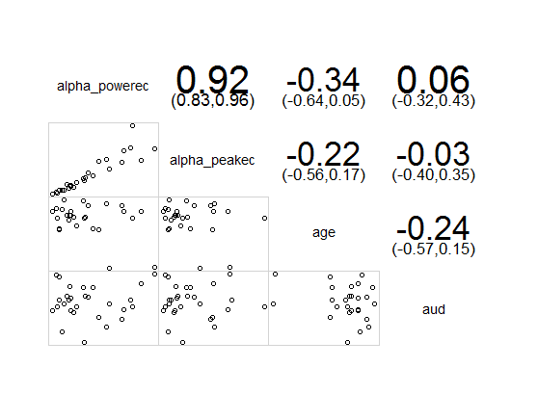
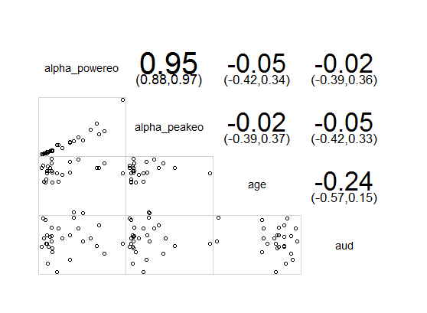
Alphapower vs age and audibility
Eyes Closed
Eyes Open

Slide 5
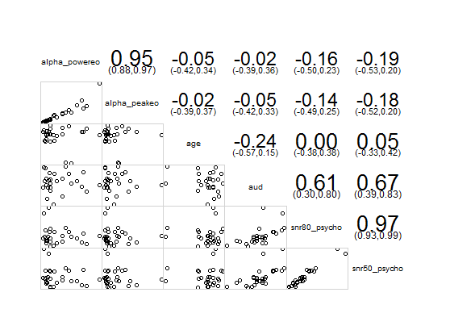

Alpha power vs SNR 50 and SNR 80

Slide 6
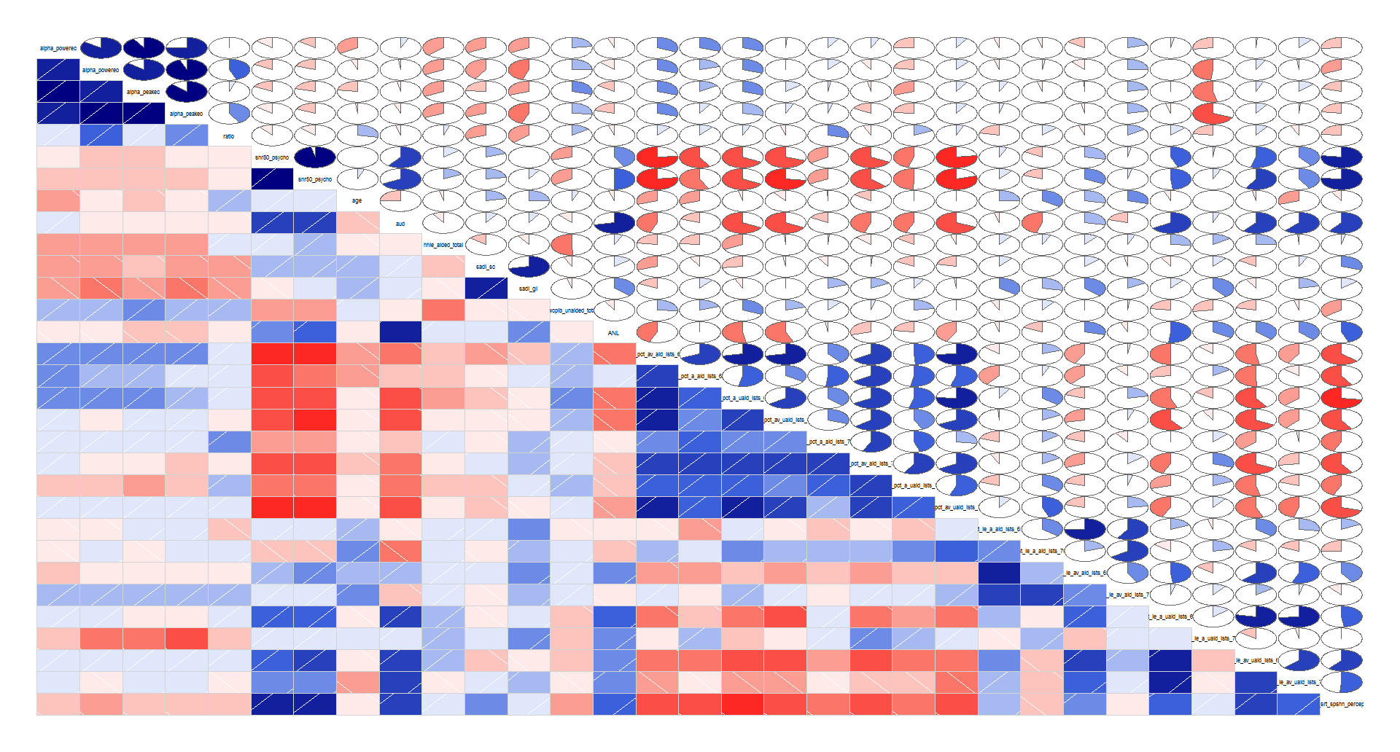

Slide 7
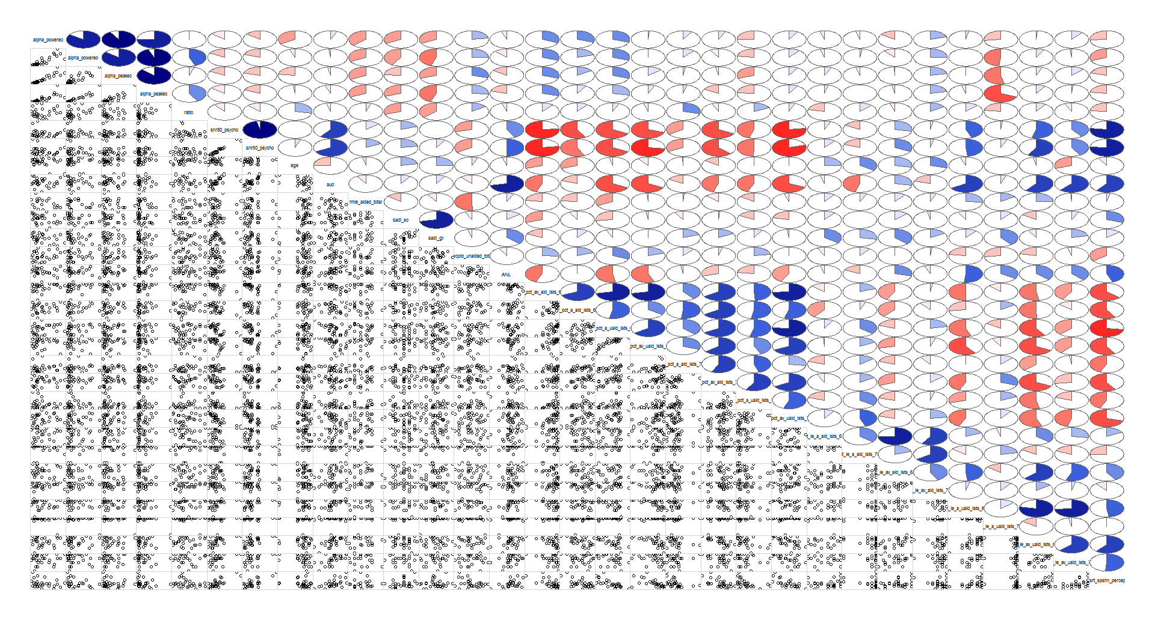

Slide 8
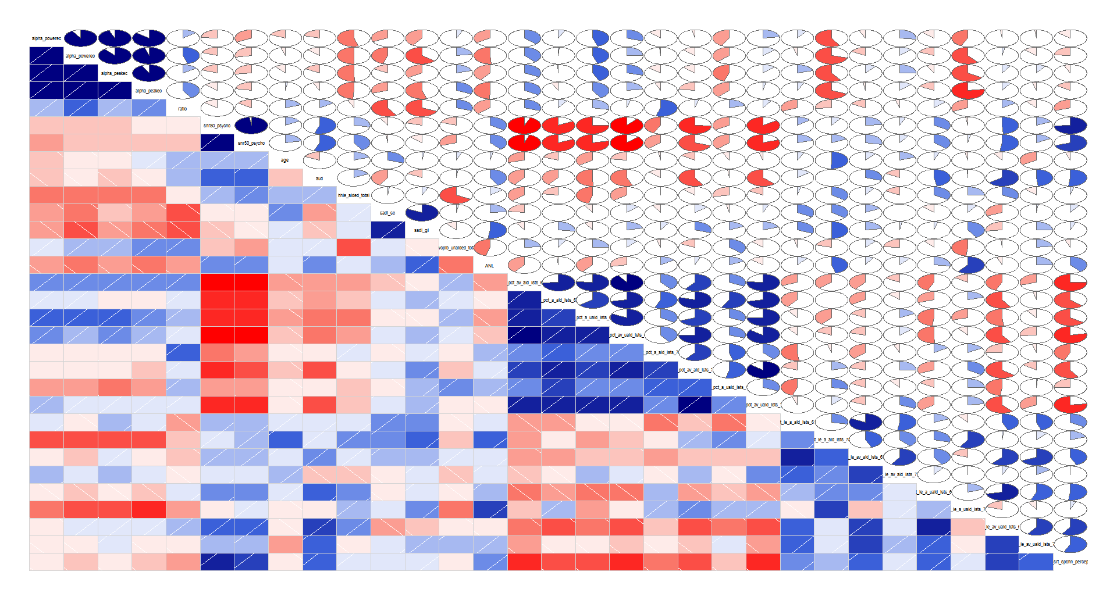
Audiobility between 25 and 40 db HL

Slide 9
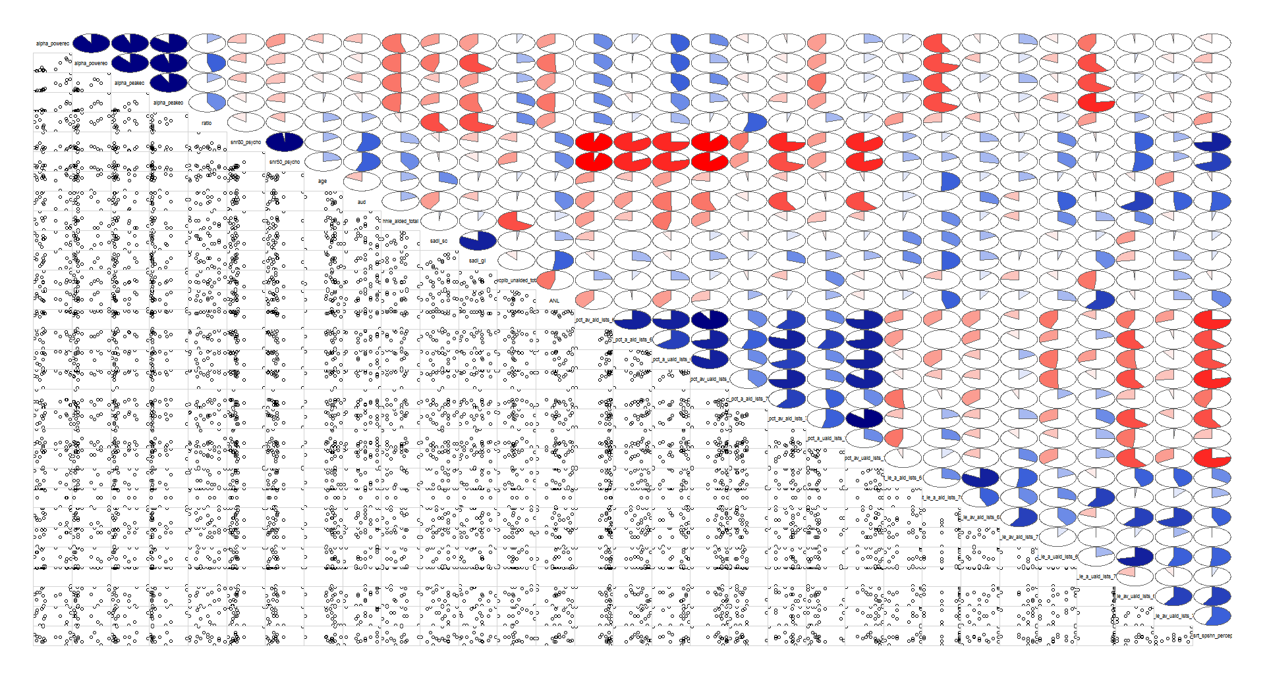
Audiobility between 25 and 40 db HL

Slide 10
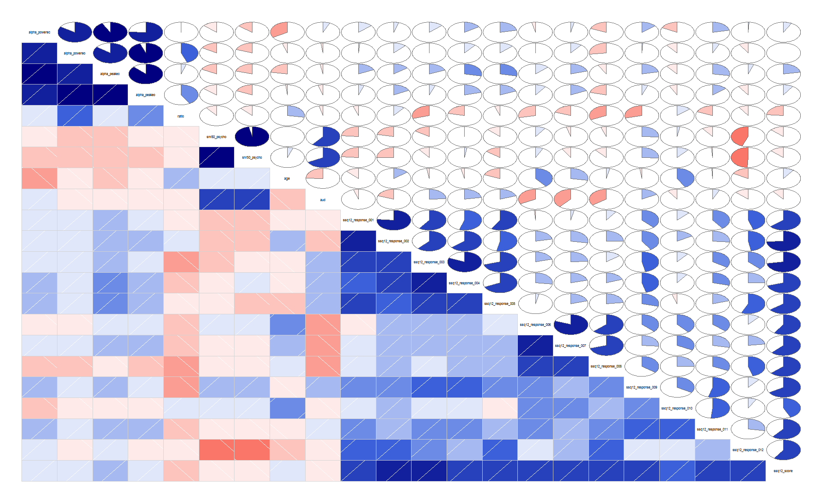
SSQ 12: Individual Responses

Slide 11
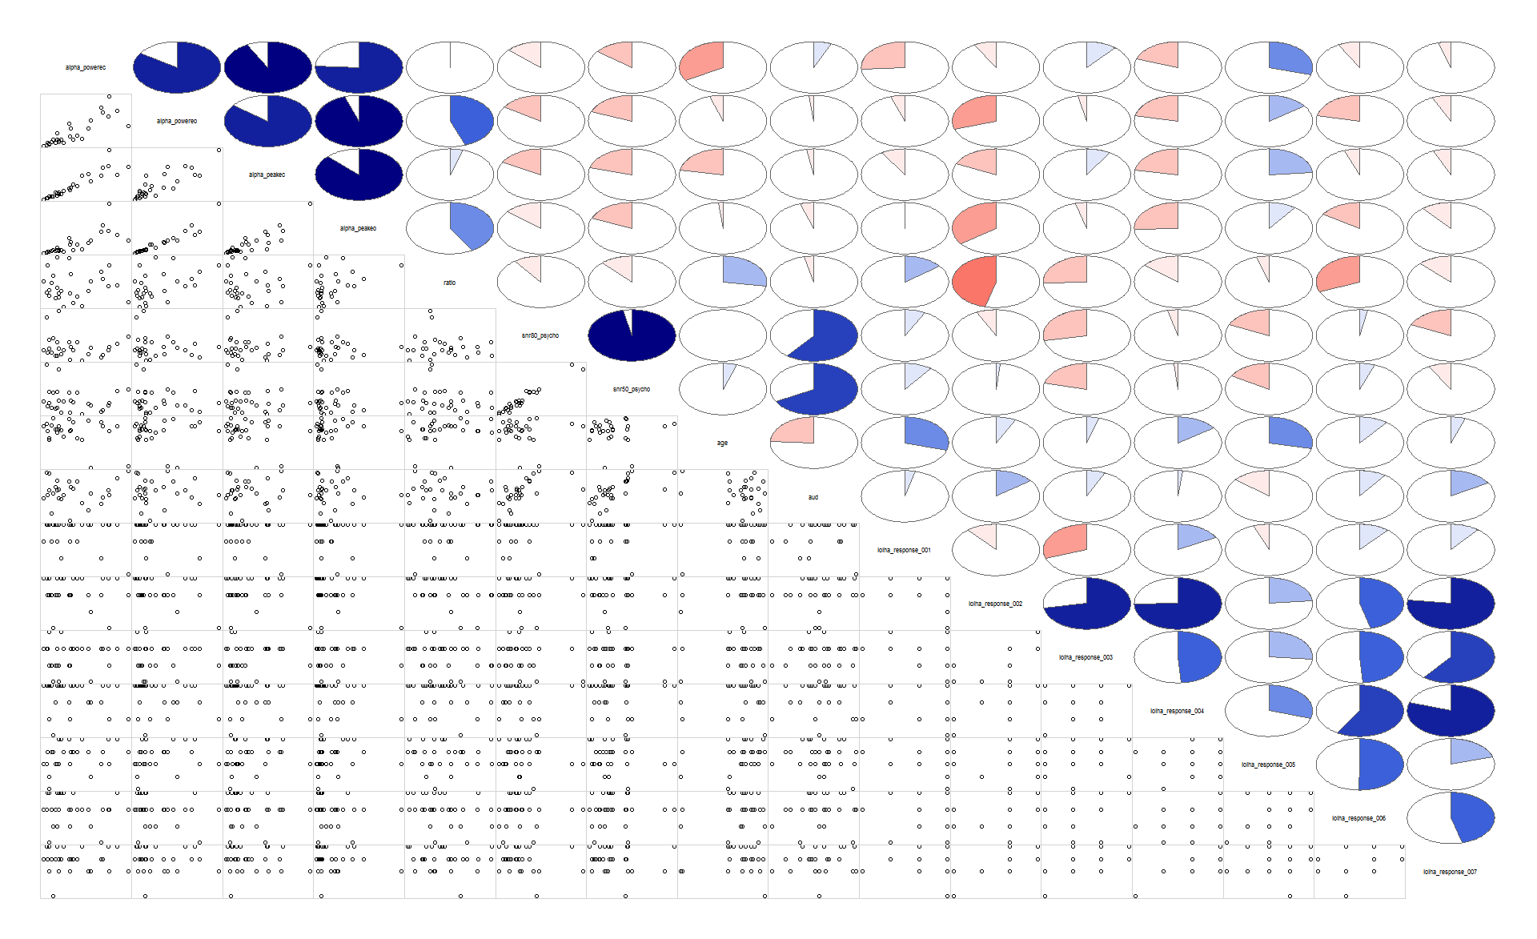
IOI: Individual Responses

Slide 12
Questions:
Measure alpha in ERP data?
ISI-2-2.5 seconds
300-400 msec alpha suppression
alpha suppression after syllable
2012 parametric variation Strauss, Neuroimage
Pz, change in alpha compared to baseline. 400-800 msec
Add noise, reduce alpha suppression.
Fieldtrip tutorial. Trials time frequency, intertrial phase coherence
Han taper window FT-frac analysis
Time frequency code

